Slide 1


<Haripriya Ramamoorthy>
<24th May 2022>

Slide 2

Outline
Executive Summary
Introduction
Methodology
Results
Conclusion

Slide 3
Executive Summary
Summary of methodologies
- Data Collection through API
- Data Collection with Web Scraping
- Data Wrangling
- Exploratory Data Analysis with SQL
- Exploratory Data Analysis with Data Visualization
- Interactive Visual Analytics with Folium
- Machine Learning Prediction
Summary of all results
- Exploratory Data Analysis result
- Interactive analytics in screenshots
- Predictive Analytics result

Slide 4
Introduction
Project background and context
Space X advertises Falcon 9 rocket launches on its website with a cost of 62 million dollars. other providers cost upward of 165 million dollars each, much of the savings is because Space X can reuse the first stage. So, if we can determine if the first stage will land, we can determine the cost of a launch. This information can be used if an alternate company wants to bid against space X for a rocket launch. The goal of this project to predict if the first stage will land successfully using a Machine Learning model.
Problems you want to find answers
- What factors determine if the rocket will land successfully?
- The interaction amongst various features that determine the success rate of a successful
landing.
- What operating conditions needs to be in place to ensure a successful landing program.

Slide 5

Section 1

Slide 6
Methodology
Executive Summary
Data collection methodology:
Data was collected using web scraping from Wikipedia and SpaceX API.
Perform data wrangling
One-hot encoding was applied to categorical features
Perform exploratory data analysis (EDA) using visualization and SQL
Perform interactive visual analytics using Folium and Plotly Dash
Perform predictive analysis using classification models
How to build, tune, evaluate classification models

Slide 7
Data Collection
Describe how data sets were collected.
- The objective was to extract the launch records as HTML table, parse the table and
convert it to a pandas dataframe for future analysis.
- Data collection was done using get request to the SpaceX API.
- Next, decoded the response content as a Json using .json() function call and turn it
into a pandas dataframe using .json_normalize().
- Then cleaned the data, handled missing values by filling in missing values where
necessary.
- In addition, performed web scraping from Wikipedia for Falcon 9 launch records with
BeautifulSoup.

Slide 8
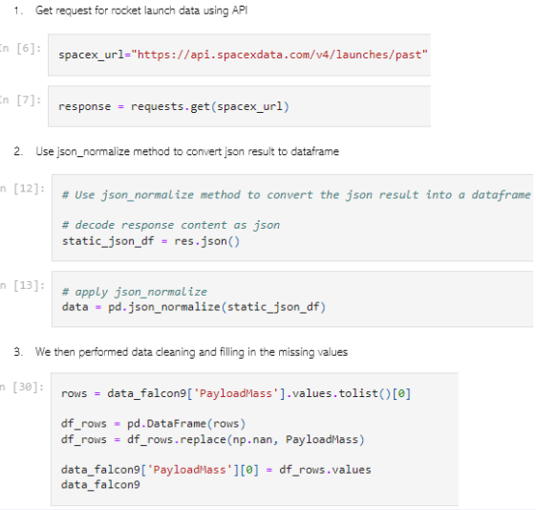
Data Collection – SpaceX API
We used the get request to the SpaceX API to collect data, clean the requested data and did some basic data wrangling and formatting.
GitHub URL of the completed SpaceX API calls notebook https://github.com/Haripriya9851/IBM-Data-Professional-Certificate/blob/main/Capstone%20Project%20-%20IBM%20Professional%20Certificate/SpaceX-data-collection-api.ipynb
Place your flowchart of SpaceX API calls here

Slide 9
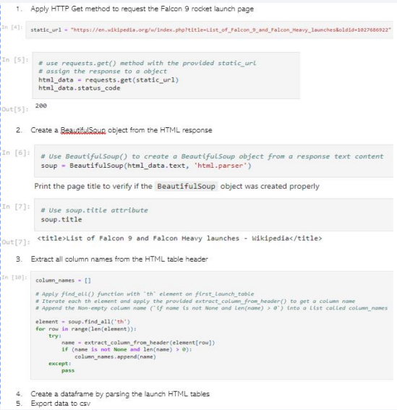
Data Collection - Scraping
Present your web scraping process using key phrases and flowcharts
GitHub URL of the completed web scraping notebook https://github.com/Haripriya9851/IBM-Data-Professional-Certificate/blob/main/Capstone%20Project%20-%20IBM%20Professional%20Certificate/SpaceX_data_collection_by_web_scrapping.ipynb
Place your flowchart of web scraping here

Slide 10

Data Wrangling
We performed exploratory data analysis and determined the training labels.
We calculated the number of launches at each site, and the number and occurrence of each orbits
created landing outcome label from outcome column and exported the results to csv.
GitHub URL of completed data wrangling notebook is https://github.com/Haripriya9851/IBM-Data-Professional-Certificate/blob/main/Capstone%20Project%20-%20IBM%20Professional%20Certificate/SpaceX_Data%20_Wrangling.ipynb
Place your flowchart of web scraping here

Slide 11

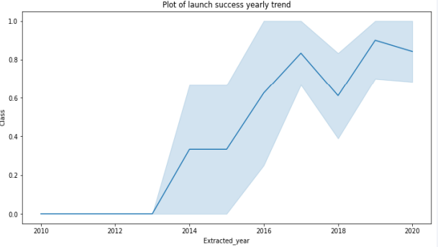
EDA with Data Visualization
We explored the data by visualizing the relationship between flight number and launch Site, payload and launch site, success rate of each orbit type, flight number and orbit type, the launch success yearly trend.
Github notebook link of EDA with Viz is https://github.com/Haripriya9851/IBM-Data-Professional-Certificate/blob/main/Capstone%20Project%20-%20IBM%20Professional%20Certificate/EDA%20with%20Data%20Visualization.ipynb

Slide 12
EDA with SQL
• Loaded the SpaceX dataset into a SQL database without leaving
the jupyter notebook.
• We applied EDA with SQL to get insight from the data. We wrote queries to
find out for instance:
- The names of unique launch sites in the space mission.
- The total payload mass carried by boosters launched by NASA (CRS)
- The average payload mass carried by booster version F9 v1.1
- The total number of successful and failure mission outcomes
- The failed landing outcomes in drone ship, their booster version and launch site names.
• The link to the notebook is https://github.com/Haripriya9851/IBM-Data-Professional-Certificate/blob/main/Capstone%20Project%20-%20IBM%20Professional%20Certificate/SpaceX-eda-sql.ipynb

Slide 13
Build an Interactive Map with Folium
We marked all launch sites, and added map objects such as markers, circles, lines to
mark the success or failure of launches for each site on the folium map.
• We assigned the feature launch outcomes (failure or success) to class 0 and 1.i.e., 0
for failure, and 1 for success.
• Using the color-labeled marker clusters, we identified which launch sites have
relatively high success rate.
• We calculated the distances between a launch site to its proximities. We answered
some question for instance:
- Are launch sites near railways, highways and coastlines.
Do launch sites keep certain distance away from cities.
GitHub notebook link of folium maps is https://github.com/Haripriya9851/IBM-Data-Science-Capstone-Project/blob/main/lab_jupyter_launch_site_location.ipynb

Slide 14
Build a Dashboard with Plotly Dash
We built an interactive dashboard with Plotly dash
• We plotted pie charts showing the total launches by a certain sites
• We plotted scatter graph showing the relationship with Outcome and Payload
Mass (Kg) for the different booster version.
• The link to the notebook is https://github.com/Haripriya9851/IBM-Data-Professional-Certificate/blob/main/Capstone%20Project%20-%20IBM%20Professional%20Certificate/app.py

Slide 15
Predictive Analysis (Classification)
Loaded the data using numpy and pandas, transformed the data, split the data into training and testing.
Built 3 different machine learning models like Tree, kNN, Logistic regression and tune different hyperparameters using GridSearchCV.
We used accuracy as the metric for model validation, improved the model using feature engineering and algorithm tuning.
Eventually found that “Decision Tree” to be the best classification model for this problem statement based on accuracy score.
The link to the notebook is https://github.com/Haripriya9851/IBM-Data-Science-Capstone-Project/blob/main/SpaceX_Machine%20Learning%20Prediction_Part_5.ipynb

Slide 16
Results
Exploratory data analysis results
Interactive analytics demo in screenshots
Predictive analysis results

Slide 17

Section 2

Slide 18
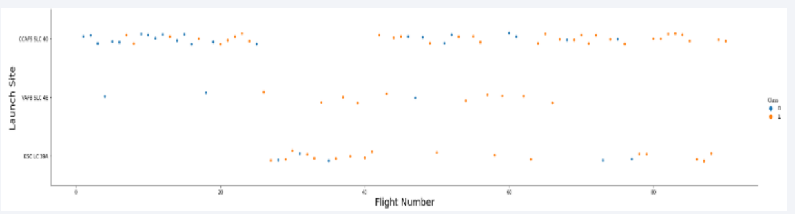
Flight Number vs. Launch Site
From the plot, we found that the larger the flight amount at a launch site, the greater the success rate at a launch site.

Slide 19

Looking at the plot, we can see that ES-L1, GEO, HEO, SSO, and VLEO are the Orbits that have high success rate. The SO has the least success rate amongst the orbits.
Success Rate vs. Orbit Type
Looking at the plot, we can see that ES-L1, GEO, HEO, SSO, and VLEO are the Orbits that have high success rate. The SO has the least success rate amongst the orbits.

Slide 20
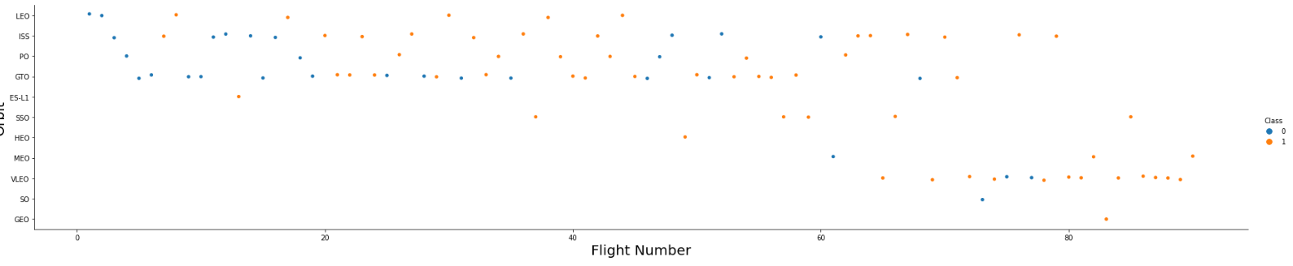
Flight Number vs. Orbit Type
in the LEO orbit the Success appears related to the number of flights; on the other hand, there seems to be no relationship between flight number when in GTO orbit.

Slide 21
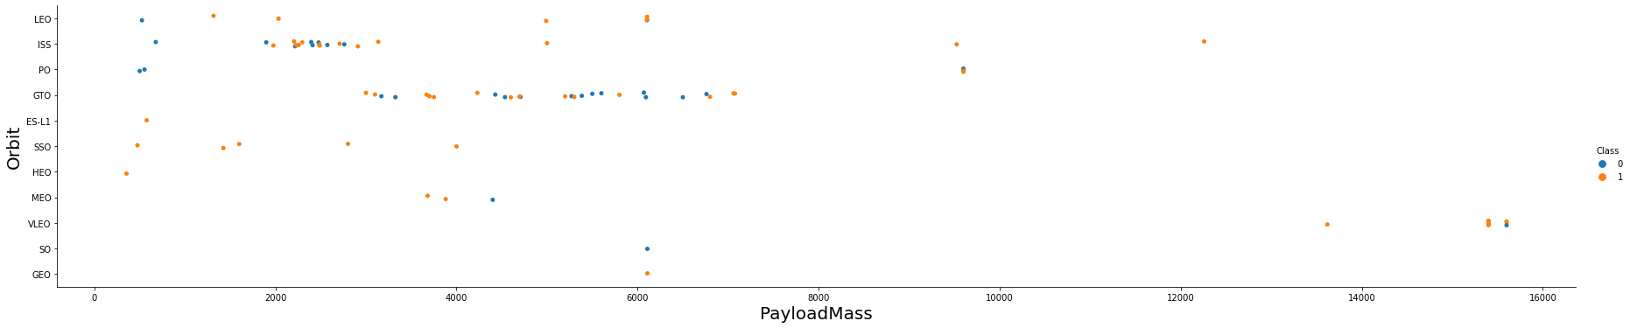
Payload vs. Orbit Type
With heavy payloads the successful landing or positive landing rate are more for Polar,LEO and ISS.
However for GTO we cannot distinguish this well as both positive landing rate and negative landing(unsuccessful mission) are both there here.

Slide 22
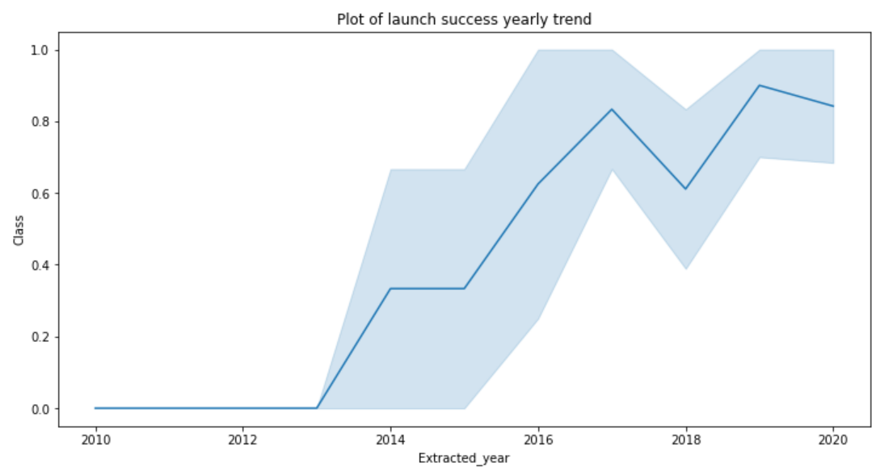
Launch Success Yearly Trend
Can observe that the sucess rate since 2013 kept increasing till 2020

Slide 23
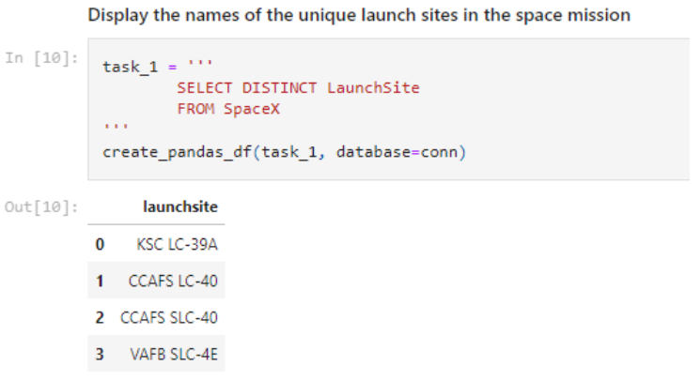
All Launch Site Names
We used the key word DISTINCT to show only unique launch sites from the SpaceX data.

Slide 24
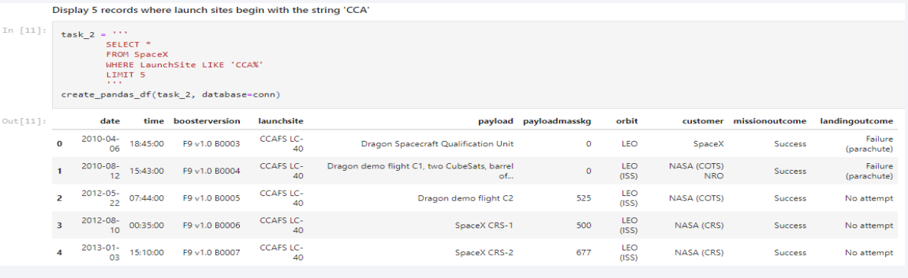
Launch Site Names Begin with 'CCA'
Used the query above to display 5 launch sites that begin with `CCA`

Slide 25
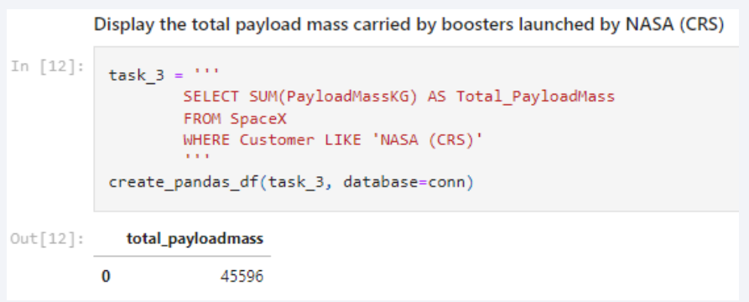
Total Payload Mass
Calculate the total payload carried by boosters from NASA

Slide 26
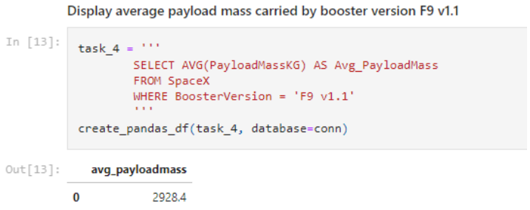
Average Payload Mass by F9 v1.1
We calculated the average payload mass carried by booster version F9 v1.1 as 2928.4

Slide 27
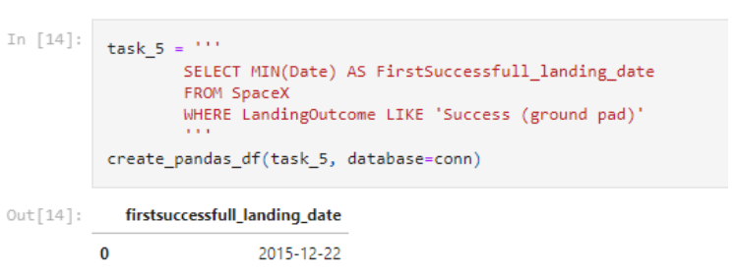
First Successful Ground Landing Date
Get the dates of the first successful landing outcome on ground pad by using Min(date) by filtering on the missions with LaningOutcome as ‘Success’

Slide 28
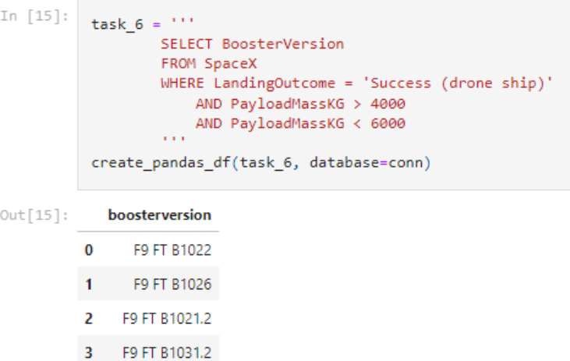
Successful Drone Ship Landing with Payload between 4000 and 6000
List the names of boosters which have successfully landed on drone ship and had payload mass greater than 4000 but less than 6000

Slide 29
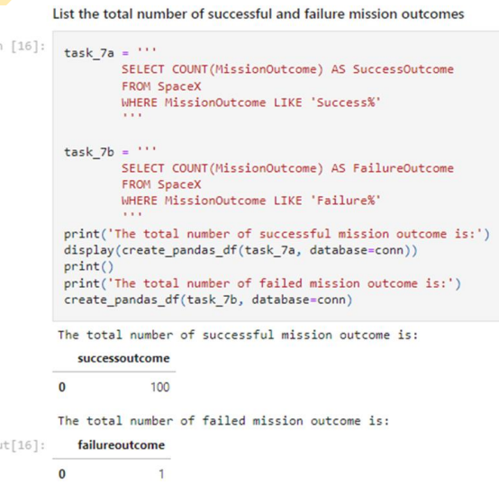
Total Number of Successful and Failure Mission Outcomes
Calculate the total number of successful and failure mission outcomes
We used wildcard like ‘%’ to filter for WHERE MissionOutcome was a success or a failure.

Slide 30
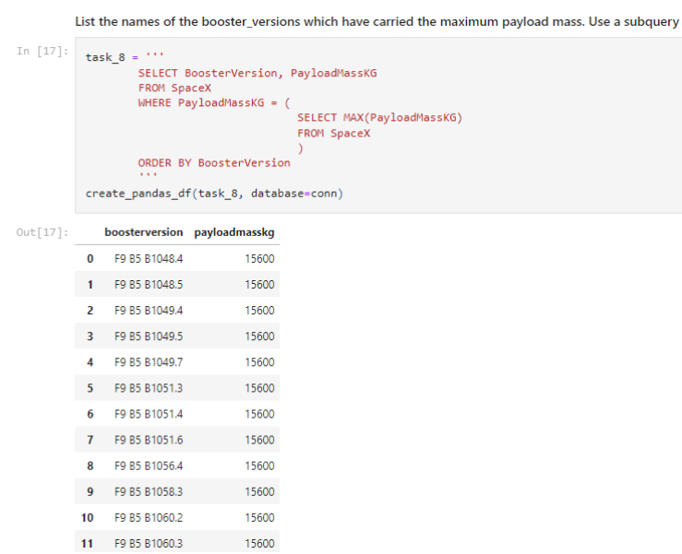
Boosters Carried Maximum Payload
List the names of the booster which have carried the maximum payload mass
We determined the booster that have carried the maximum payload using a subquery in the WHERE clause and the MAX() function.

Slide 31
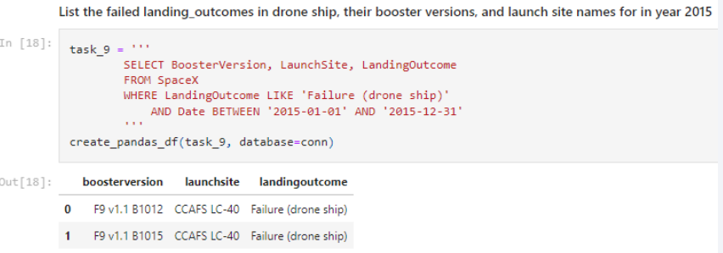
2015 Launch Records
List the failed landing_outcomes in drone ship, their booster versions, and launch site names for in year 2015
We used a combinations of the WHERE clause, LIKE, AND, and BETWEEN conditions to filter for failed landing outcomes in drone ship, their booster versions, and launch site names for year 2015

Slide 32
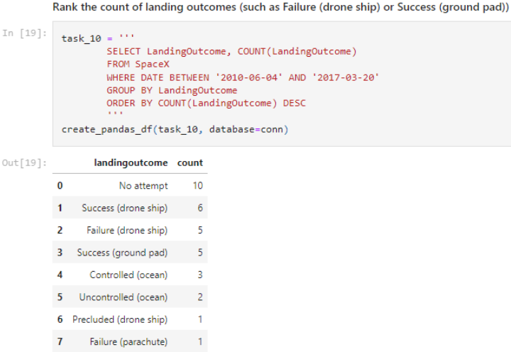
Rank Landing Outcomes Between 2010-06-04 and 2017-03-20
Selected Landing outcomes and the COUNT of landing outcomes from the data and used the WHERE clause to filter for landing outcomes BETWEEN 2010-06-04 to 2010-03-20.
Then applied the GROUP BY clause to group the landing outcomes and the ORDER BY clause to order the grouped landing outcome in descending order

Slide 33

Section 3

Slide 34

All launch sites global map
Launch sites in map are marked in red. And one observation is that all sites are near the sea.

Slide 35

Color labeled Successful and Unsuccessful Launch Sites
From the color-labeled markers in marker clusters, you should be able to easily identify which launch sites have relatively high success rates.

Slide 36
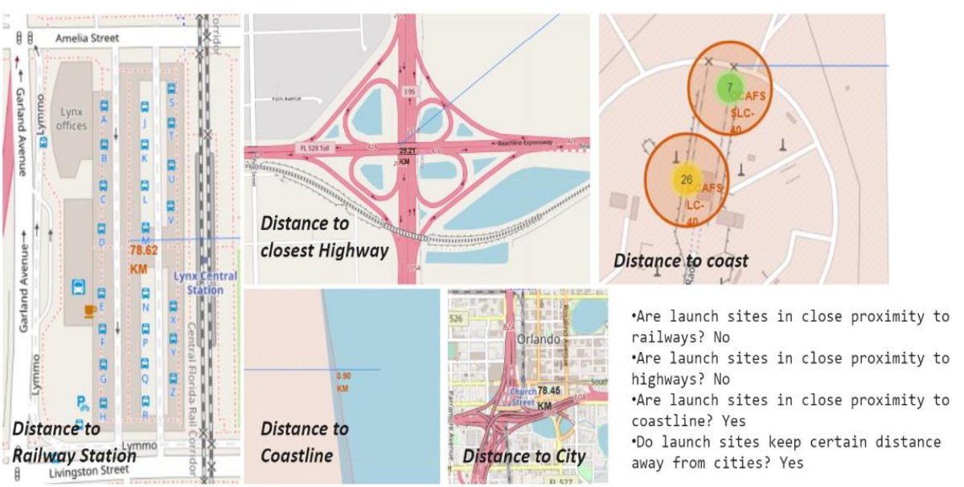
Launch Site distance to landmarks
selected launch site to its proximities such as railway, highway, coastline, with distance calculated and displayed

Slide 37

Section 4

Slide 38
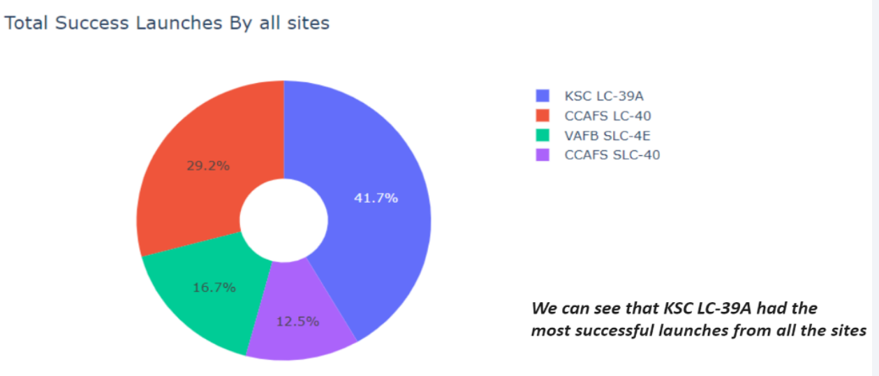
Pie chart showing the success percentage achieved by each launch site

Slide 39
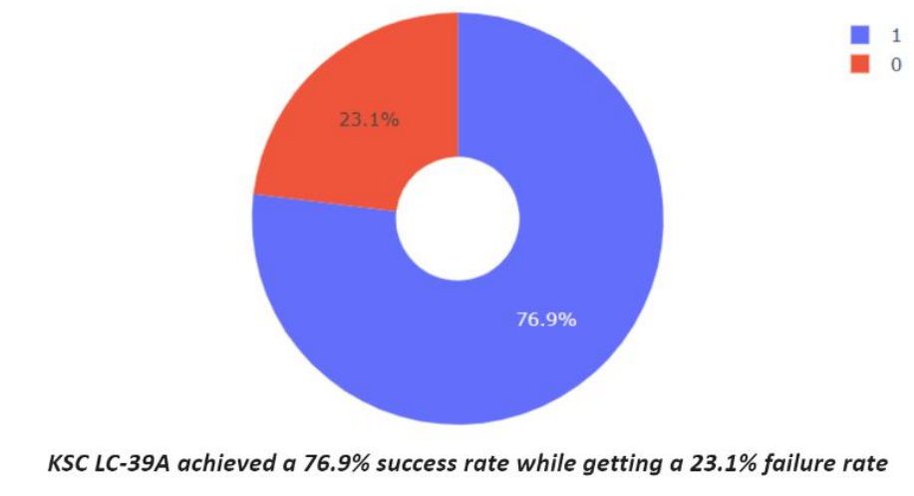
Pie chart showing the Launch site with the highest launch success ratio

Slide 40
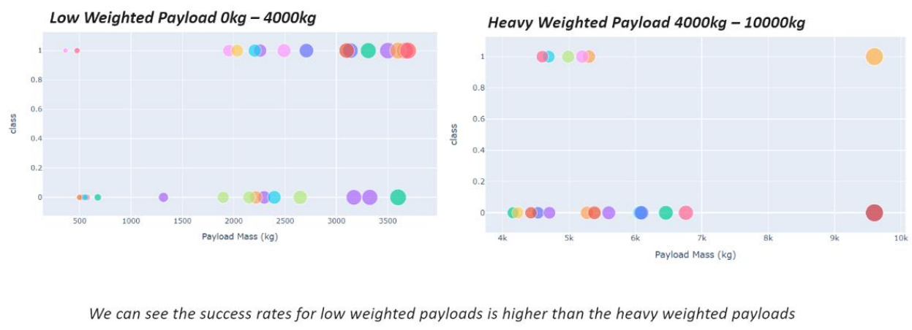
Scatter plot of Payload vs Launch Outcome for all sites, with different
payload selected in the range slider

Slide 41

Section 5

Slide 42
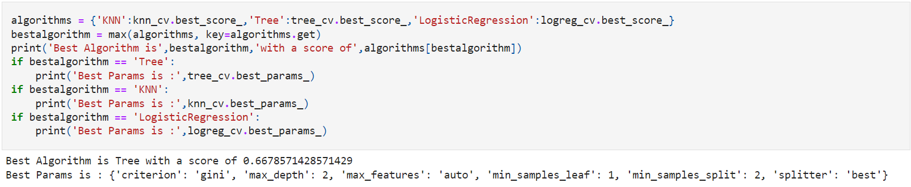
Classification Accuracy
Decision Tree classification model has best accuracy

Slide 43
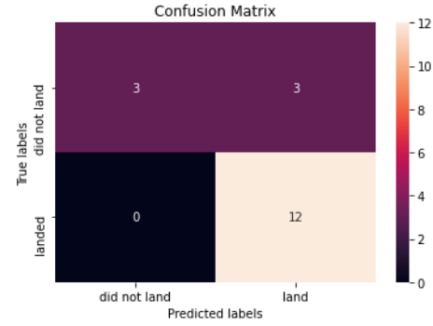
Confusion Matrix
The confusion matrix for the decision tree classifier shows that the classifier can distinguish between the different classes. The major problem is the false positives .i.e., unsuccessful landing marked as successful landing by the classifier.

Slide 44
Conclusions
We can conclude that:
The larger the flight amount at a launch site, the greater the success rate at a launch site.
Launch success rate started to increase in 2013 till 2020.
Orbits ES-L1, GEO, HEO, SSO, VLEO had the most success rate.
KSC LC-39A had the most successful launches of any sites.
The Decision tree classifier is the best machine learning algorithm for this task.

Slide 45


